Slide 1
Discrete Structures
CH 01: Logic and Proofs

Slide 2
Content
The Foundations: Logic and Proofs
Propositional Logic
Applications of Propositional Logic
Propositional Equivalences
Predicates and Quantifiers
Nested Quantifiers
Rules of Inference
Introduction to Proofs

Slide 3

Propositional Logic
Logic rules are used to distinguish between valid and invalid mathematical arguments.
A proposition is a declarative sentence (a sentence that declares a fact) that is either true or false, but not both.
Propositions are the basic building blocks of logic.

Slide 4
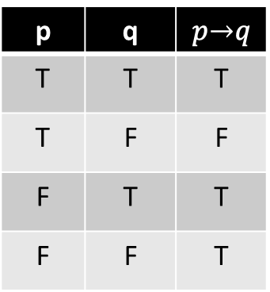
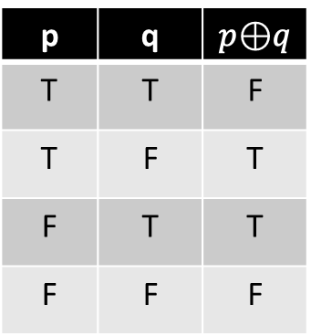
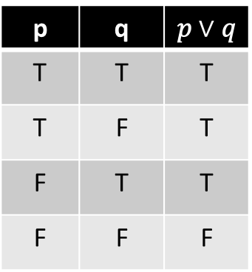
Propositional Logic
Logical Operations
Negation (¬𝑝)
Conjunction ($p ∧ q$)
Conjunction (𝑝 ∧ 𝑞)
Disjunction ($p ∨ q$)
Disjunction (𝑝 ∨ 𝑞)
Conditional ($p → q$)
Conditional (𝑝 → 𝑞)
Exclusive ($p ⊕ q$)
Exclusive (𝑝 ⊕ 𝑞)
p | q | 𝑝 ∧ 𝑞
T | T | T
T | F | F
F | T | F
F | F | F
p | q | 𝑝 $∨$ 𝑞
T | T | T
T | F | T
F | T | T
F | F | F
p | q | 𝑝$⊕$𝑞
T | T | F
T | F | T
F | T | T
F | F | F
p | q | 𝑝$→$𝑞
T | T | T
T | F | F
F | T | T
F | F | T
p | ¬𝑝
T | F
F | T

Slide 5




Propositional Logic
Related conditional statements
CONVERSE
CONTRAPOSITIVE
INVERSE
$$p → q$$
$$q → p$$
$$¬q →¬p$$
$$¬p →¬q$$
Only the contrapositive always has the same truth value as $p → q$.

Slide 6
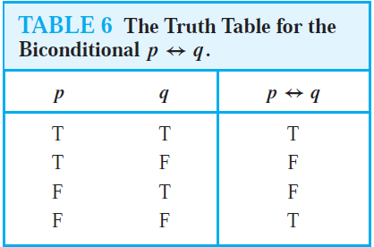

Propositional Logic
The biconditional statement $p ↔ q$is the proposition “p if and only if q.”
The biconditional statement $p ↔ q$ is true when $p$ and $q$ have the same truth values and is false otherwise.

Slide 7
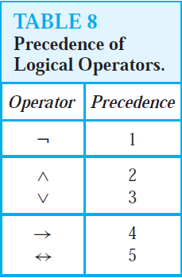
Propositional Logic
Precedence of Logical Operators

Slide 8
Content
The Foundations: Logic and Proofs
Propositional Logic
Applications of Propositional Logic
Propositional Equivalences
Predicates and Quantifiers
Nested Quantifiers
Rules of Inference
Introduction to Proofs
Proof Methods and Strategy

Slide 9
Applications of Propositional Logic
Translating English Sentences
System Specifications
Boolean Searches
Logic Puzzles
Logic Circuits

Slide 10
Content
The Foundations: Logic and Proofs
Propositional Logic
Applications of Propositional Logic
Propositional Equivalences
Predicates and Quantifiers
Nested Quantifiers
Rules of Inference
Introduction to Proofs

Slide 11
Propositional Equivalences
Tautology
A compound proposition that is always true
Contradiction
A compound proposition that is always false
Contingency
A compound proposition that is neither a tautology nor a contradiction
Definition 1:

Slide 12
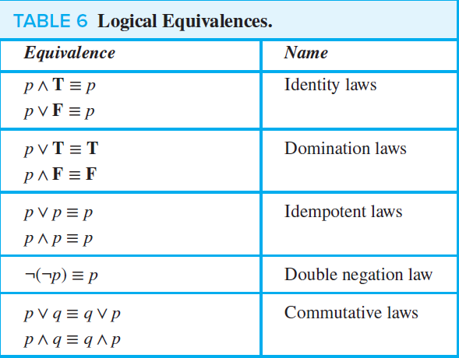
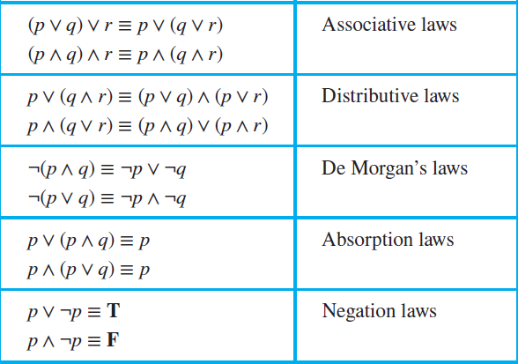
Propositional Equivalences
Table 6 contains some important equivalences.

Slide 13
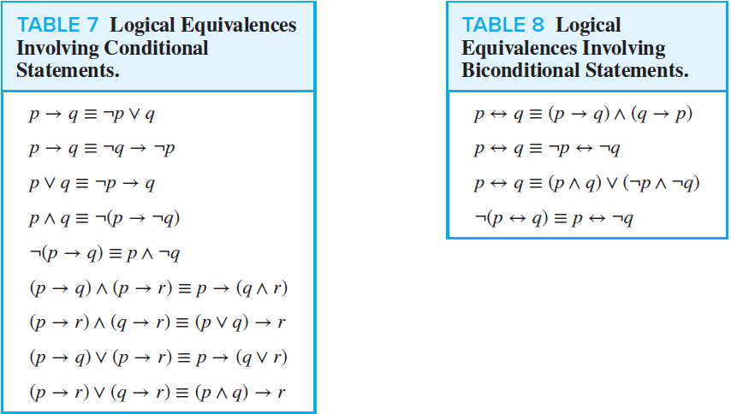
Propositional Equivalences

Slide 14
Propositional Equivalences
The notation $\bigvee_{j =1}^{n}{p_{j}}$ means $p_{1} ∨ p_{2} ∨⋯∨ p_{n}$
The notation $\bigwedge_{j =1}^{n}{p_{j}}$ means $p_{1} ∧ p_{2} ∧⋯∧ p_{n}$.

Slide 15
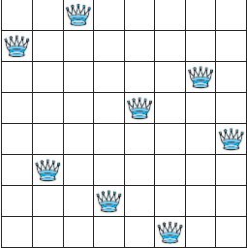
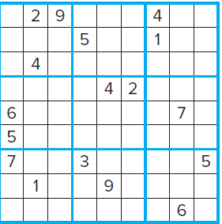
Propositional Equivalences
Satisfiability:
A compound proposition is satisfiable if there is an assignment of truth values to its variables that makes it true. $(p ∨ ¬q) ∧ (q ∨ ¬r) ∧ (r ∨ ¬p)$
A compound proposition is unsatisfiable when the proposition is false for all assignments of truth values to its variables. $\left(p ∨ ¬q\right)∧ \left(q ∨ ¬r\right)∧ \left(r ∨ ¬p\right)∧ \left(p ∨ q ∨ r\right)∧ \left(¬p ∨ ¬q ∨ ¬r\right)$
Applications of Satisfiability:
The n-queens problem
Sudoku

Slide 16
Content
The Foundations: Logic and Proofs
Propositional Logic
Applications of Propositional Logic
Propositional Equivalences
Predicates and Quantifiers
Nested Quantifiers
Rules of Inference
Introduction to Proofs

Slide 17
Predicates and Quantifiers
Predicate logic is used to solve statements involving variables, such as
“x > 3,” “x = y + 3,” “x + y = z,”
“Computer x is under attack by an intruder,”
“Computer x is functioning properly,”
The first part, the variable $x$, is the subject of the statement.
The second part of the statement is called the predicate.
The statement $P(x)$ is also said to be the value of the propositional function $P$ at $x$.

Slide 18
Predicates and Quantifiers
Quantification expresses the extent to which a predicate is true over a range of elements.
Quantifiers
universal quantification
existential quantification
A predicate is $true$ for every element under consideration
There is one or more element
under consideration for which the predicate is $true$.

Slide 19
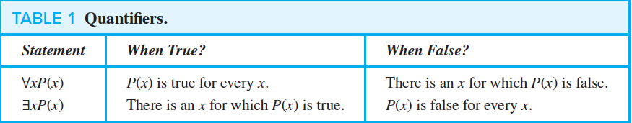
Predicates and Quantifiers

Slide 20
Predicates and Quantifiers
Negation of universal quantifier: $¬∀xP(x) ≡ ∃x ¬P(x).$
Negation of existential quantifier: $¬∃xQ(x) ≡ ∀x ¬Q(x).$

Slide 21
Content
The Foundations: Logic and Proofs
Propositional Logic
Applications of Propositional Logic
Propositional Equivalences
Predicates and Quantifiers
Nested Quantifiers
Rules of Inference
Introduction to Proofs

Slide 22
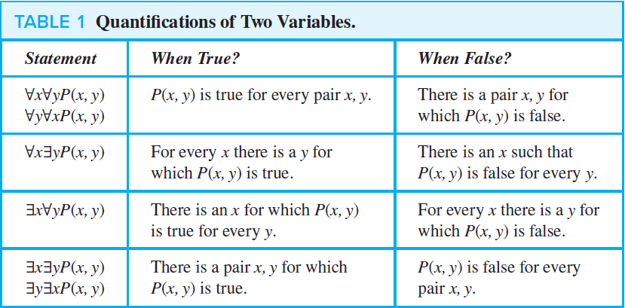
Nested Quantifiers
THINKING OF QUANTIFICATION AS LOOPS:
$∀x∀yP(x, y)$
$∀x∃yP(x, y)$
$∃x∀yP(x, y)$
$∃x∃yP(x, y)$

Slide 23
$$∃x∃y P(x,y)$$
$$X$$
$$Y$$
When True? | When False?
There is a pair $x, y$for which $P(x, y)$is $true$. | $P(x,y)$ is $false$ for every pair $x, y$

Slide 24
$$∃x∀yP(x, y)$$
$$X$$
$$Y$$
When True? | When False?
There is an $x$ for which $P(x, y)$ is $true$ for every $y$. | For every $x$ there is a $y$ for which $P(x, y)$is $false$.

Slide 25
$$∀x∃yP(x, y)$$
$$X$$
$$Y$$
When True? | When False?
For every $x$ there is a $y$ for which $P(x, y)$is $true$. | There is an $x$ such that $P(x, y)$ is $false$ for every $y$.

Slide 26
$$∀x∀yP(x, y)$$
$$X$$
$$Y$$
When True? | When False?
$P(x, y)$is $true$ for every pair $x, y$. | There is a pair $x, y$for which $P(x, y)$ is $false$.

Slide 27
Content
The Foundations: Logic and Proofs
Propositional Logic
Applications of Propositional Logic
Propositional Equivalences
Predicates and Quantifiers
Nested Quantifiers
Rules of Inference
Introduction to Proofs

Slide 28

Rules of Inference
Definition: Argument: is a sequence of propositions.
All but the final proposition in the argument are called premises
The final proposition is called the conclusion.
An argument is valid if the truth of all its premises implies that the conclusion is true.
$$“If you have a current password, then you can log⁡onto the network.”$$
Argument
Premises
Conclusion

Slide 29
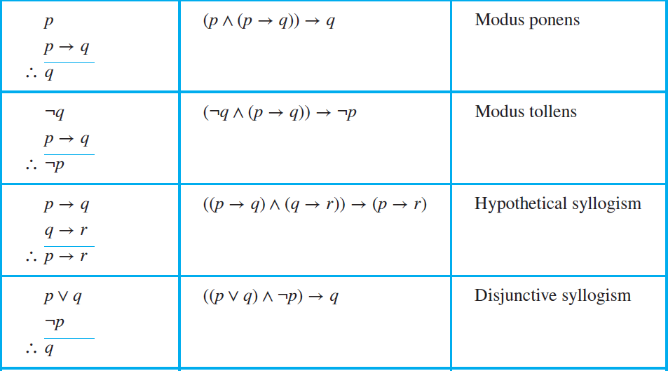
Rules of Inference
To determine if the argument is valid, we use rules of inference

Slide 30
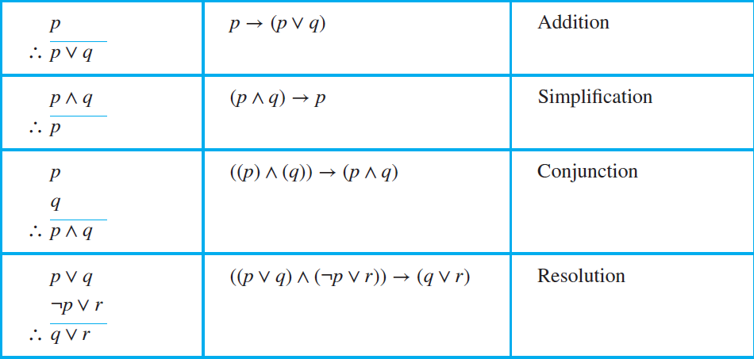
Rules of Inference
To determine if the argument is valid, we use rules of inference

Slide 31
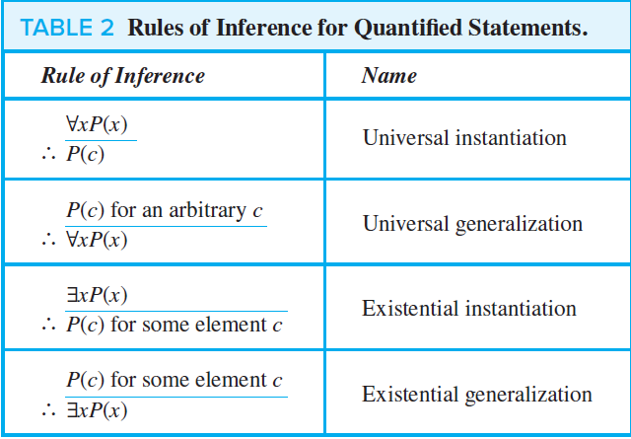
Rules of Inference
Rules of Inference for Quantified Statements.

Slide 32
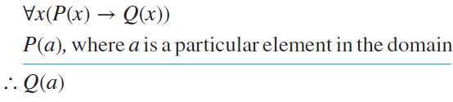
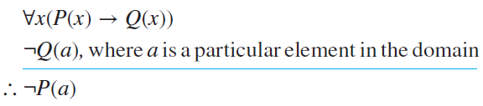
Rules of Inference
Universal modus ponens:
Universal modus tollens:

Slide 33




Rules of Inference
Fallacies are rules of inference based on contingencies rather than tautologies.
Fallacies
Affirming the conclusion.
Denying the hypothesis.
The proposition $((p → q) ∧ q) → p$
is not a tautology, because it is false when $p$ is false and $q$ is true.
The proposition $((p → q) ∧ ¬p) → ¬q$ is not a tautology, because it is false when $p$ is false and $q$ is true.
“If I have an iPhone, then I have a good camera”
“I have a good camera”
$∴$ “I have an iPhone”
“If I have an iPhone, then I have a good camera”
“I do not have an iPhone”
$∴$ “I do not have a good camera”

Slide 34
Content
The Foundations: Logic and Proofs
Propositional Logic
Applications of Propositional Logic
Propositional Equivalences
Predicates and Quantifiers
Nested Quantifiers
Rules of Inference
Introduction to Proofs

Slide 35
Introduction to Proofs
A theorem is a statement that can be shown to be true.
A proof is a valid argument that establishes the truth of a theorem.
Methods of Proving Theorems
Direct Proofs
Proof by Contraposition
Proofs by Contradiction

Slide 36

Introduction to Proofs
A direct proof of a conditional statement $p → q$ is constructed by:
Assume that $p$ is true.
Use $p$ to show that $q$ must be true.

Slide 37

Introduction to Proofs
Proofs by contraposition (indirect proof) make use of the fact that the conditional statement $p → q$ is equivalent to its contrapositive, $¬q → ¬p$.
The conditional statement $p → q$ is proved by showing that its contrapositive, $¬q → ¬p$, is true.

Slide 38

Introduction to Proofs
Proof by contradiction assumes the theorem is false, and then show that the assumption itself is false, and is therefore a contradiction.
Assume that $p$ is true and $q$ is false, then prove that $(p ∧ ¬q) → F$.

